Slide 1


MSIL - Digital Checksheet Filling System Evaluation Proposal
13th February 2023
July 2020
Notes:
Plug in intro

Slide 2


Our Understanding of the Requirement
System Architecture
Assumptions and Dependencies
Execution & Governance
AGENDA

Slide 3


Requirement & Scope

Slide 4
Our Understanding of the Requirement
MSIL has a business process of Vehicle Inspection where all the vehicles are inspected after the assembly process. Operators record their observations at their respective stations on a pre-printed paper-based check sheet. This check sheet moves with the vehicle at each station across Vehicle Inspection shop.
MSIL is working on digitalizing this paper-based process to electronic media. In the new digitalized process, there will be no paper flow and the operator will use handheld devices to fill the observations of inspection.
MSIL has designed the solution and is looking for a possible IT partner to support the development of such a solution.
MSIL wants to understand the estimated effort and various IT skills that would be required for this digitalization activity.
MSIL has proposed following solution components
Business Admin based Web App Flow : Process upload and manage master files containing checkpoint/ Checksheet related details
Approval based Web app Flow : Process for approval of uploaded masters by business admin
Mobile app Flow : Process to view, fill and submit checksheets by shop floor operators
Slide 4

Slide 5
Functional Requirements
Functional requirements for this proposal are considered from the RFI shared with Happiest under following functionality types.
General / Base functionality (#1 - #41)
Data Requirements (#42 - #50)
Security Requirements (#51 - #55)
Reporting Requirements (#56 - #66)
Notification Requirements (#67 - #69)
Slide 5

Slide 6
In Scope and Out of Scope
In Scope
Out of Scope
Design and Development of
Web Portal
Android App
Backend Microservices
Responsive User Interface (desktop/laptop)
Functional Testing
User Acceptance Testing Support
Infrastructure Set Up & Basic pipeline (2 environments)
Basic Performance Testing
Language Support – English only
Functional Requirement
Location based access restriction
System Integration other than MSIL Identity Provider
Mobile Push Notification
Mobile App
Deploy App in Google Play Store
Offline Support
User Experience (UX)
Test Automation (API, UI and Mobile)
Security Testing (PEN)
Accessibility
Warranty Support (2 weeks)
User manual, SOP, Runbook documentation

Slide 7
Browsers and Devices Supported
Browser | Windows Desktop OS version
Android | 13, 12, 11
Google’s Chrome | Windows 10
Edge | Windows 10

Slide 8
Proposed Approach

Slide 9
















System Architecture
Web App
Master sheet Management
(Upload, List, edit..)
Approval UI
(Summary, list, actions)
EKS
Business Users
Reference image
(Upload and map images)
View Check sheets
Amazon S3
CloudFront
User Service
RBAC Service
Notification
Reporting
Amazon SQS
Report Service
Check sheet Service
Skill master Management
User Management & RBAC
Notification service
workflow service
Skill master service
Inspector User
Mobile App
Authorizer
Schedule
**
**
The above architecture diagram depicts high level architecture of the solution. The application will be deployed in AWS Cloud.
** Integration with MSIL Data lake and MSIL CRM are not part of scope
MSIL Federation Identity
MSIL Data lake
MSIL CRM
9

Slide 10
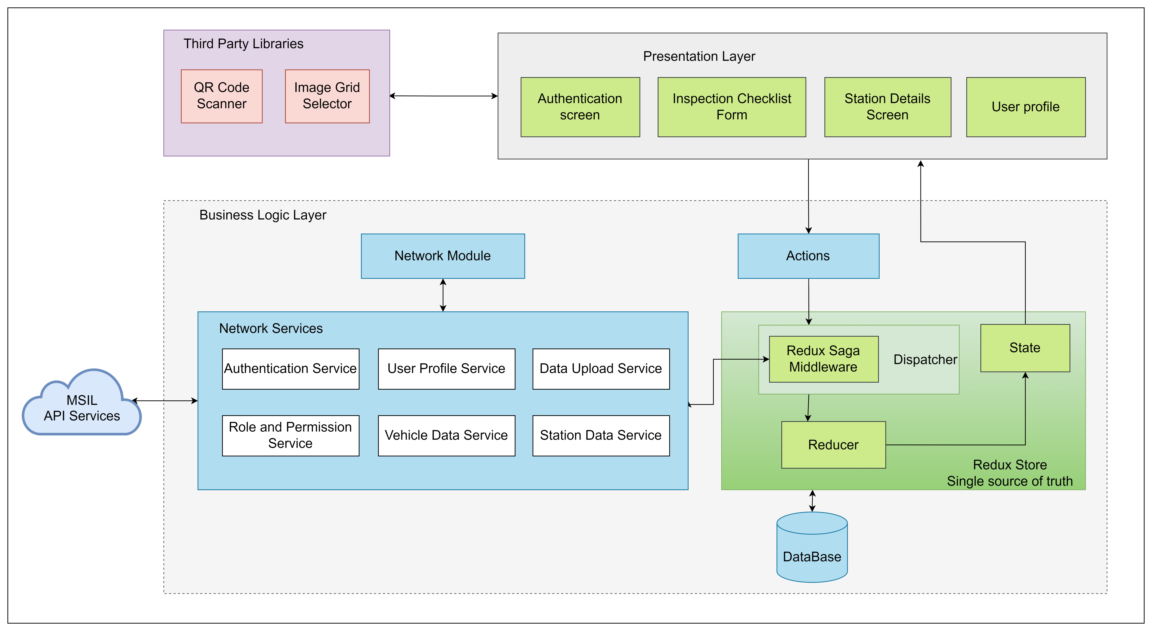
Architecture - Mobile

Slide 11
Design Considerations
Cloud First Design
Microservices / API First
Scalable
Modularity
Maintainability
Common look & feel. Follow MSIL User Experience Guidelines for GUI design
Use existing MSIL Authentication system

Slide 12
High level Approach
Authentication & Authorization
MSIL federated Integration for all MSIL users, Non-MSIL user registration and profile management will be part of platform. RBAC service will help managing all kind of roles.
Platform Services
Backend services will be container based micro services.
All tailor-made composite APIs for the business requirements will be exposed through API Gateway.
All API response will be JSON except the download report which will support pdf.
Security
API will be secured through access token (JWT), which the Web clients will pass over auth headers on each request.
API will be authorized using auth tokens for each user based on their roles and permissions.
All communications are over SSL, which secures the request-response with data encryption.

Slide 13
High level Approach
The application will have a set of well-defined services. The following are the services.
Master Sheet Management: This Module will be supporting create, list , upload different kind of master sheet required for check sheet processing within check sheet repositories
Workflow & Auditing: This module will be support for approval workflow for master sheet, publish different check sheets. Grid and reference images upload, audit log, versioning of check sheets functionalities.
Notification: This module will be supporting Email Notification for different stockholders along with scheduled mode for remainder service.
Reporting: All kind of possible report download, and view supported by this module.
Skill Master Management- Manage and list for different skill masters required for Mobile application, this module is responsible for provide other API’s as well like summary, upload, inspection submit, station wise report views

Slide 14
High level Approach
Web Application
The Web application shall be built using the latest version of React and will be hosted on Amazon S3. Following are the major modules in the proposed web application.
Master sheet Management
Approval workflow
Upload reference images
View check sheets
Notification
Reports
Skill master management
Mobile Application
The mobile application shall be developed using React Native framework. Below are major modules as mentioned in architecture
Presentation Layer – This layer includes the screens visible for the user
Business Layer – This layer includes all the business logic, Network services and state management modules
Third Party Libraries – React Native plugins for QR scanning and Image annotation will be used

Slide 15
Testing Approach
The functional testing shall be carried out as per the identified requirements in the requirement document. The focus areas of testing will be :
Functional Web application testing: Simulate different user behavior on the application and validate the behavior of the application as per the requirements. Role Based Access Control (RBAC) testing would be conducted considering all the various type of users in the system. Workflow testing would be considered to validate all the relevant approval/rejection flows. Story validations are done at sprint level and end-to-end testing would be covered as part of integration & regression testing.
Mobile App testing: Mobile features for shop floor operator would be validated on all the agreed devices. Our mobile app testing would cover functional testing, interruption testing & installation/uninstallation testing. All the test cases would be executed on latest Android and iOS devices. Sanity test cases would be executed on all the other agreed devices.
UI Testing: Verify every page in the web application with focus on the User Interface aspects such as the font sizes and colors, hyperlinks, logos, images and banners, position of various UI elements on the pages etc. and ensure look and feel are as per the requirements.
Compatibility Testing : All the UI testcases would be executed at least once on the agreed browsers. We would execute all the test cases on primary browser and sanity test cases (mainly on UI rendering) on other agreed browsers.
Performance Testing: Basic performance testing covering critical services

Slide 16
Technology Stack (Indicative)
Feature | Technology Stack
User Interface | React JS, React Native
Unit Test | Jest
Cloud | AWS
API Gateway | AWS API gateway
Microservice / Scripting Language | Node
Messaging | SQS, SNS
Cache | Redis
Authentication & Authorization | Active Directory , JWT
Database | RDS
DevOps | Git, CI/CD, Docker, Kubernetes

Slide 17
Assumptions and Dependencies

Slide 18
Assumptions
No other external system integration required except MSIL Federated integration for Authentication
Barcode scan capability provided by MSIL infra team for integration
All Master check sheets upload are done by MSIL admin user from local, not from any other external feed
Reports are limited to only csv formatted
Non-MSIL users and their skills will be created and managed in this application
The web application UI will be supported in all the screen resolutions above 1280 x 768 pixels (Desktop/Laptop).
This effort estimation is based on the current understanding of the requirements and assumptions. The efforts might change based on the changes in the requirements.
MSIL team will procure license for any commercial libraries used in the project

Slide 19
Dependencies on MSIL
Dependency Factors | To be available by
Product owner for the knowledge transition of the application, clarification, and review of the user stories | Start of the project
Technical SPOC for feedback and clarifications | Start of the project
Provide any coding guideline or standards that happiest minds must follow for development | Start of the project
Sample Master check sheets, Report format , Sample QR code | Start of the project
MSIL Federated test users and SDK’s | Start of the project
UX for Mobile and Web App | Start of the project
Email/Notification format and content | Start of the project
Code repository access (MSIL Git Repo) | Start of the project
AWS account for environment setup along with Database Details | Start of the project
Review UAT Test Case document | As needed during the project
Response to Happiest Minds’ queries within two business days. Any delays in response might have an impact on the effort and schedule & will be treated as a Change Request, | As needed during the project
Feedback on the deliverables for each milestone must be provided within 3 days of the delivery by Happiest Minds, else, they shall be deemed accepted | During entire project engagement

Slide 20
Execution Approach

Slide 21

Our Agile Process
SCRUM
teams
Happiest Minds leverages
SCRUM Agile framework for:
Prioritized Product backlog
Sprint Retrospective
Creating tailor made team structure
Inducing high customer engagement
Directional alignment of the team
Facilitating near real-time updates
Maintain transparency
Keeping daily check on delays
Facilitating customer feedback
Predictable Quality and delivery
Continuous learning and improvement
Foster Best practices
SCRUM
Framework
Daily
meetings
Sprint
Planning
Sprints
Time box

Slide 22











Agile: Sprint Cycle
Daily Scrum
Sprint Review at the end of every sprint
Prioritized Product Backlog
Sprint of 2 weeks
Sprint reports on Jira/Confluence
Finished Work
Sprint planning at start of every sprint
Sprint Backlog
Backlog Grooming
Sprint Retrospective at the end of every sprint
MSIL
SPOC (Happiest Minds)
Happiest Minds team

Slide 23


Governance Model
Escalation
Path
Escalation
Path
Executive Team
Quarterly
Executive Team
Milestones, Roadmaps
Program Manager
Monthly / Fortnightly
Project Manager / Delivery -
Manager
Status, Reviews, Budgets
Project Team / SME
Weekly / Need based
Project Team / SME
Status, Issues
MSIL

Slide 24
Communication Plan
Communication Area / Topic | Communication Activity Area(s) | Audience | Timeline/Frequency | Owner
Internal Stakeholder Outreach & Communications | Functional Requirements Meetings Story Grooming | Product Management & Technical Teams | Weekly | Project Manager & Dev Leads
Standard Project Reporting & Communications | Daily Scrum Meeting Iteration Planning & Retrospection Weekly Status Report Meeting Notes & Actions Items Project Schedule & Milestone progress reporting | Project Team; Stakeholders | Daily/Weekly – ongoing communications activities | Project Manager & Technical Team
Other Communication Practices to overcome language barriers | Usage of Chat tools – Slack, Teams, etc. Sharing Agenda and documentation before any review call | Project Teams | Ongoing | Managers from both teams

Slide 25
Execution Schedule and Deliverables
Below is indicative schedule and deliverables which will be finalized in the 1st week of the project along with MSIL team
Milestone | Due Date in Weeks | Owner | Deliverables
Project Kickoff | T | Happiest Minds | Signed SOW document
Requirement and Solution | T + 1 | MSIL & Happiest Minds | Basic requirement documentation Solution and tech stack finalization Data base design
Milestone – 1 | T + 7 | MSIL & Happiest Minds | MSIL Federated integration with microservice User management and RBAC service Upload service including grid and reference images Check sheet service Skill Master service
Milestone – 2 | T + 11 | MSIL & Happiest Minds | Workflow & publish integration Notification service with scheduled remainder Report service Audit log and check sheet versioning Check sheet search and filter
UAT | T + 12 | MSIL & Happiest Minds | UAT testing (MSIL) UAT Test report Bug fixes

Slide 26
Proposed Team Structure (Indicative)
# | Skill Required | Experience in Years | Further bifurcation of technical skills (if available)
1 | Project Manager/Scrum master | 10 + years | Project Management, Agile project delivery, JIRA
2 | Business Analyst | 5+ years | Requirements gathering, User Story creation, JIRA,
3 | Technical Architect | 10+ years | Node, AWS, React, Architecture and Design
4 | Full Stack Lead | 7+ years | ReactJS/ Node
5 | Sr. Backend Developer | 5+ years | Node
6 | Backend Developer | 2+ years | Node
7 | Sr. Frontend Developer | 5+ years | ReactJS
8 | Sr. Mobile Developer | 5+ years | React Native
9 | Mobile Developer | 2+ years | React Native
10 | Sr. QA Tester (Functional) | 5+ years | Functional testing, Regression testing, Database testing
11 | QA Tester (Functional) | 2+ years | Functional testing, Regression testing, Database testing
12 | DevOps Engineer | 5+ years | CI-CD pipeline creation, deployment, Jenkins
This is tentative team structure proposed based on the high-level understanding of the requirement and scope of work

Slide 27
Abhijit Yadav
Client Partner – MSIL
abhijit.yadav@happiestminds.com
+91 8888866647

